Slide 1

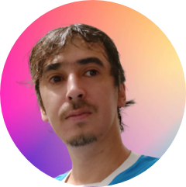

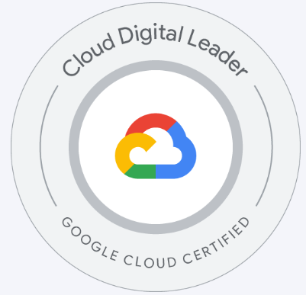
Juan Manuel Carranza
SELECTED EXPERIENCE
American Television Network (01-2023– 12 -2023)
Build an AI assisted Migration Tool to automate migration from BQ SQL scripts to DBT pipelines.
Implement LLM (Google PaLM2) automatic technical and business documentation on DBT models.
Implementation of a monitoring framework for scheduled queries in BigQuery and validation queries in GitHub. The notification was sent to a custom Slack channel with a unified message after a failure was detected in the pipeline.
The main components used in GCP were Cloud Functions and Airflow in Composer, Vertex AI, Pub-Sub.
Design of the architecture of a monitoring framework for scheduled queries in BigQuery and validation queries in GitHub
Number 1 US Global Retail Company (05-2022– 01 -2023)
As a Cloud Migration Engineer I was responsible for the migration of Batch processes from different sources to GCP (Google Cloud Platform).
Experience in modifying bash scripts to work properly in GCP, comparing it with what the client had on-premises.
Meetings/Pair-programming with international Data Engineers in order to find/develop a solution for an existing problem.
Debugging of SQL queries in Dataproc, Bash Scripts.
Understanding existing Python code in order to debug failed steps or steps that were not doing what they were intended to do.
Support for Production issues.
Git and GitHub.
Assestment at international mini group (04/2022)​
Support in the design of an integral solutions based on databricks and ml models with a strong focus on DevOps automation.
Data Engineering Consultant – Accenture (2021– 2022)​
Develop and operate all aspects of ML.
Infrastructure: Deployment, Monitoring of metrics, latency and throughput.
Data drift, concept drift.
ML Engineering Specialist
DevOps - SRE - MLOps
juan.carranza@accenture.com
Buenos Aires, Argentina
PROFESSIONAL BACKGROUND
AREA OF EXPERTISE
12 years experience specializing in the monitoring, observability, tracing and logging solutions, infrastructure and operation automation, maintenance and troubleshooting, system design and capacity planning, full stack classic and cloud infrastructure administration, CI/CD Pipelines. I manage a wide range set of tools with different degrees of expertise, docker, kubernetes, zabbix, prometheus, jenkins, airflow, DBT, rundeck, git, bash, python, mariadb, postgre, mssql, ansible, Pulumi, terraform, influxdb, kafka, helm, flux, argocd, and many more. My goal is to always be learning new tools that allow me to optimize my work and provide better solutions. Try, fail, try again and learn continuously is what I intend to do on a daily basis.
HARD/SOFT SKILLS & TOOLS
Python
DBT
Cloud platforms GCP – Azure
Linux
Airflow
Apache Tomcat
Helm
MySql
Rundeck
Docker
Kubernetes
Zabbix
Jenkins
IaC Ansible – Terraform - Pulumi
InfluxDB
Prometheus
Azure DevOps
SPECIALIZATIONS
Azure fundamentals certified.​
GCP Cloud Digital Leader certified.
INDUSTRY
LANGUAGES
Retail
Energy
Infrastructure support
Logistics
Television
Spanish (Native)
English (C1)
Accenture Applied Intelligence

